Slide 1

Together we can make a difference

Slide 2
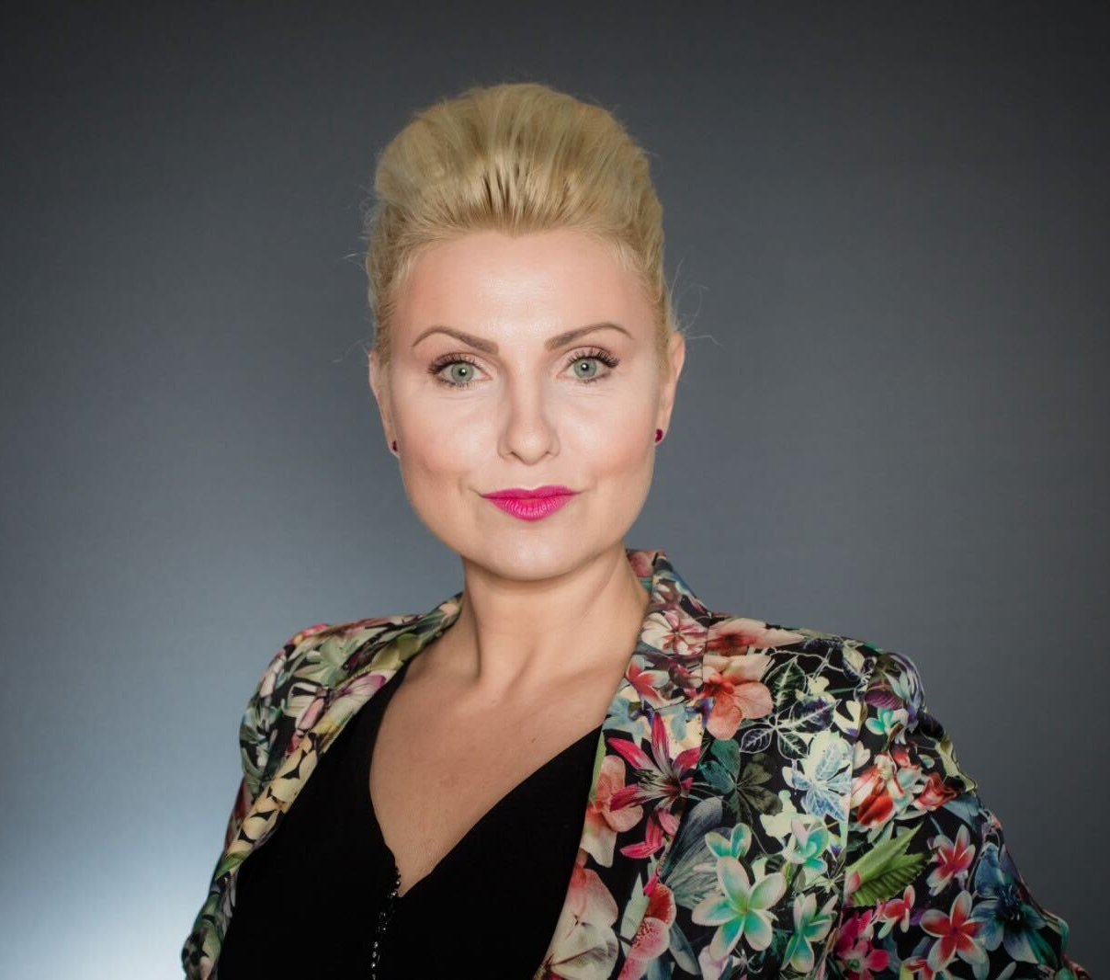
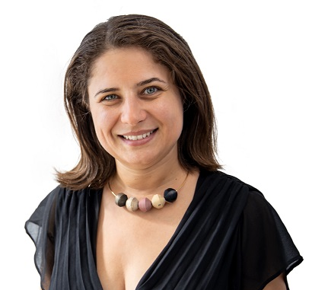
Magda Bei – volunteer and the coordinator of Max Leaders project guide and manage Estern Region
Oana Yucel - volunteer coordinator for this projects

Slide 3

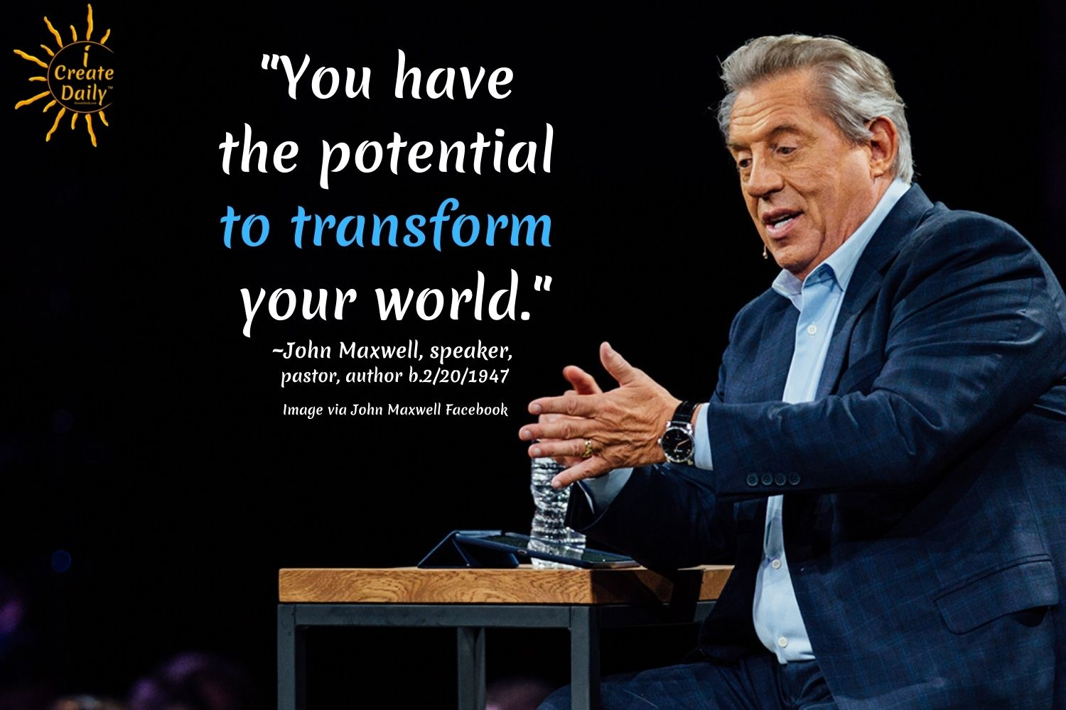
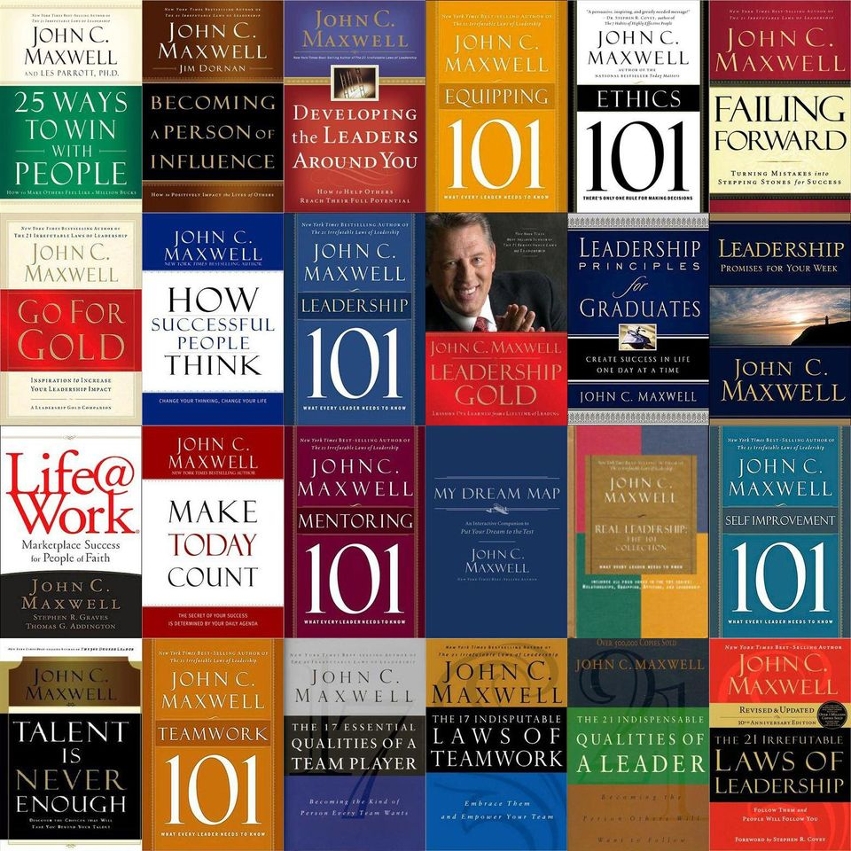
International initiative to support the young
The International leadership day is now
celebrated on John C. Maxwell’s birthday on February 20th
John Maxwell sold 21 million copies of his books

Slide 4

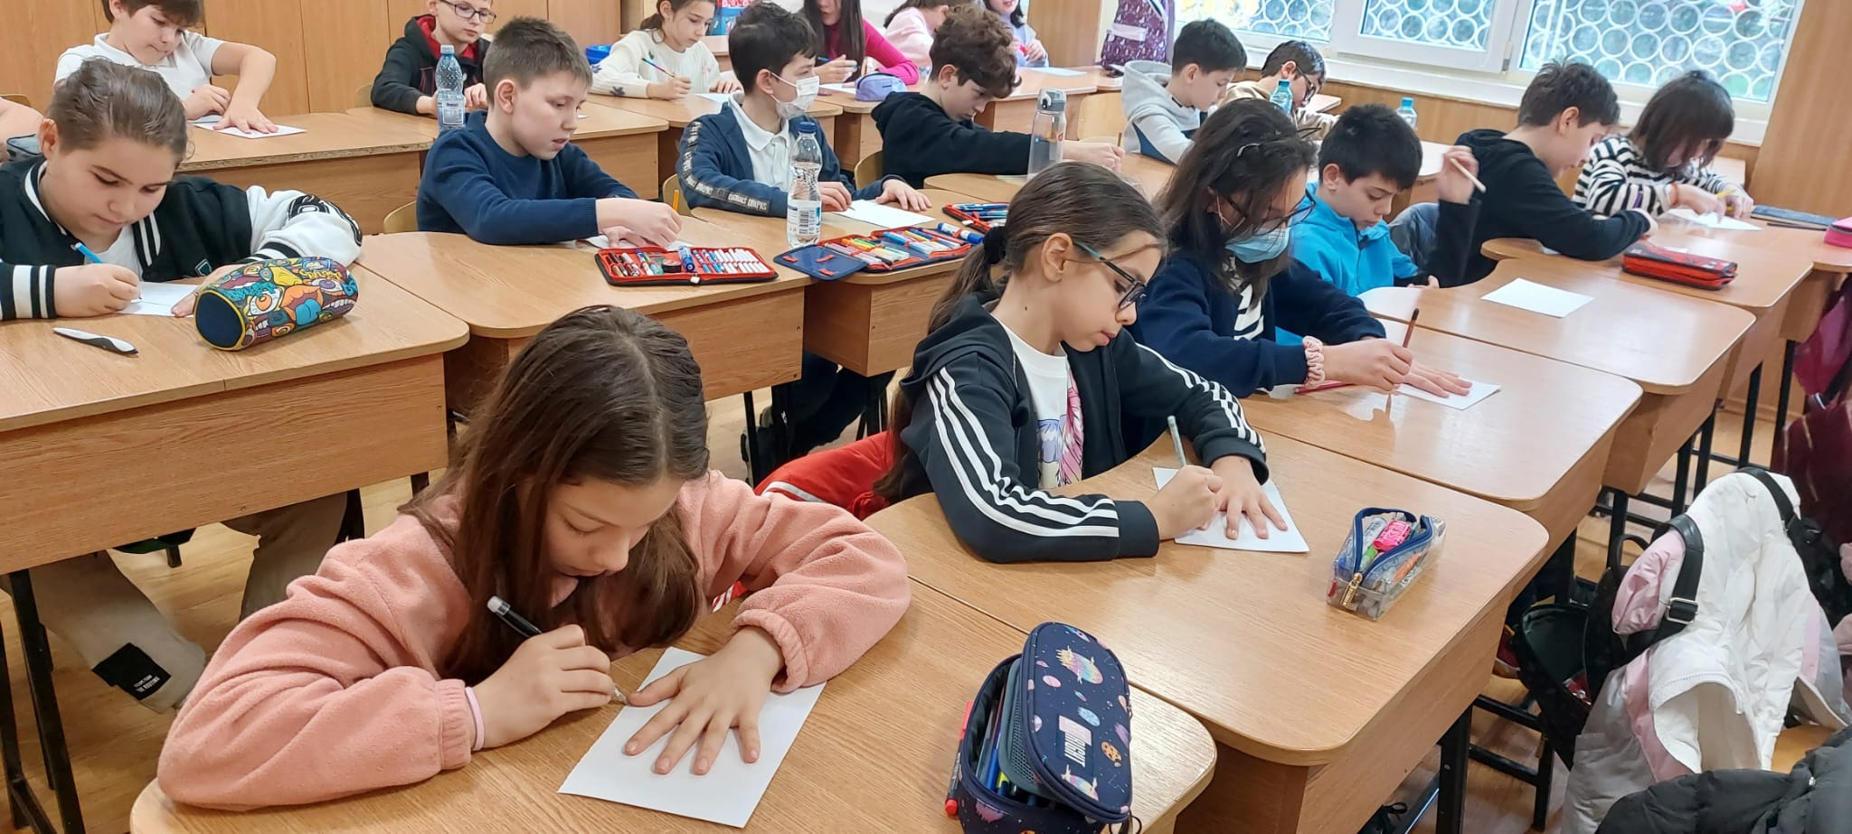
The Romanian Maxwell foundation began personal development project for high school students with 12 lesson curriculum approved by the Ministry of Education.
Being well received , we decided to create a guide and also to integrate it in a mobile app.
all for reaching a bigger audience.

Slide 5
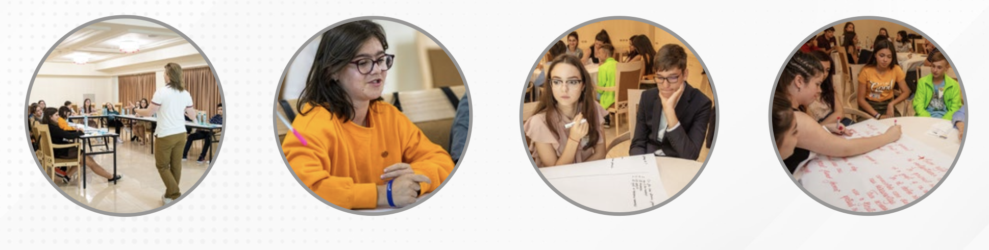
We held 2600 personal development sessions for students,
provided by a number of 1500 voluntary classroom teachers,
and the beneficiaries being more than 45000 young people,
The personal development guide for students between 9th - 12th grade. They will receive this knowledge during management hours
starting with the new school year 2023-2024.

Slide 6
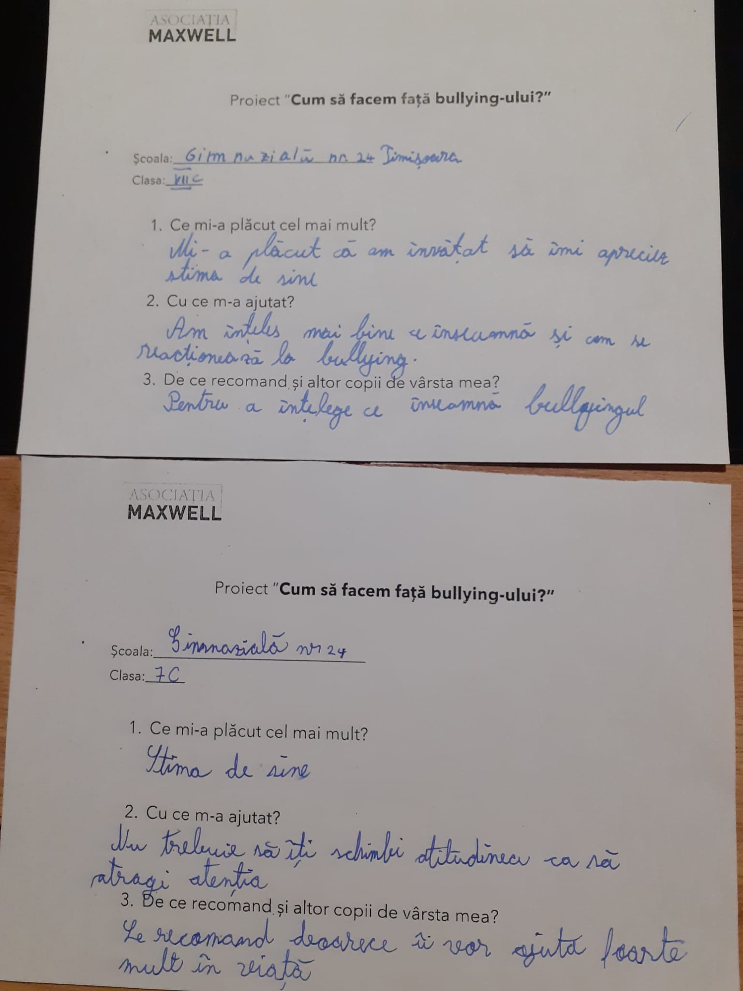
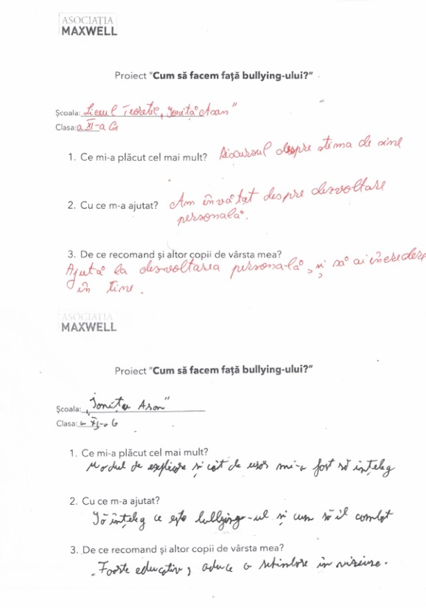
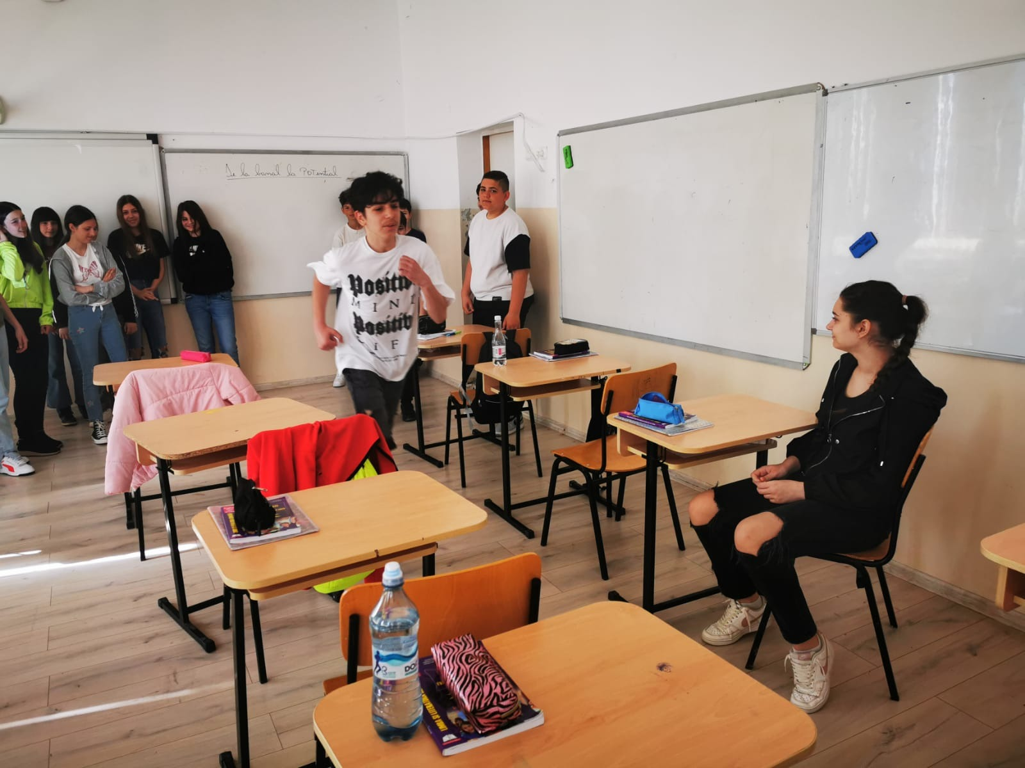
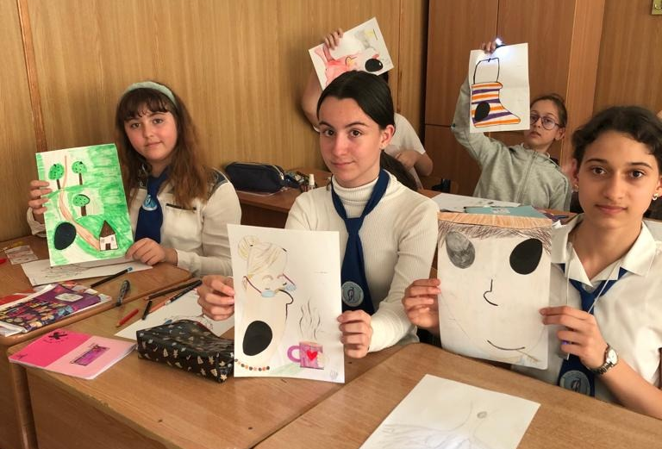
We had the support of educators all over the country
that brought us valuable feedback from the kids
that was the fundamental finishing touch to our material.

Slide 7
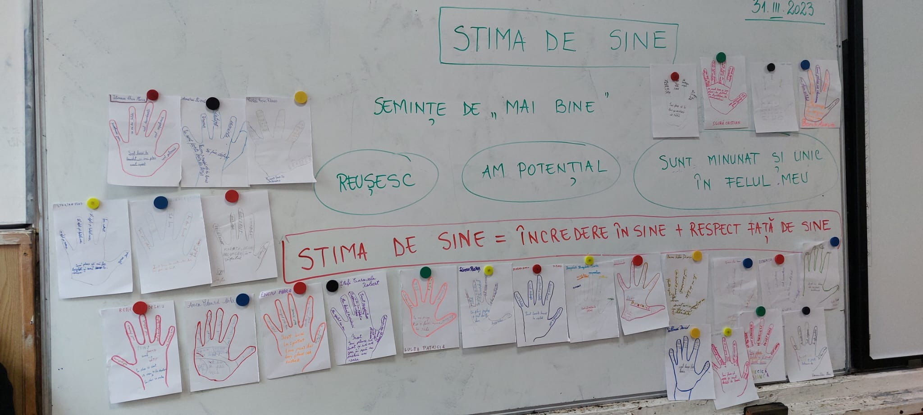
We invest in young people - We invest in the future! photo : exemple from self -esteem lesson

Slide 8
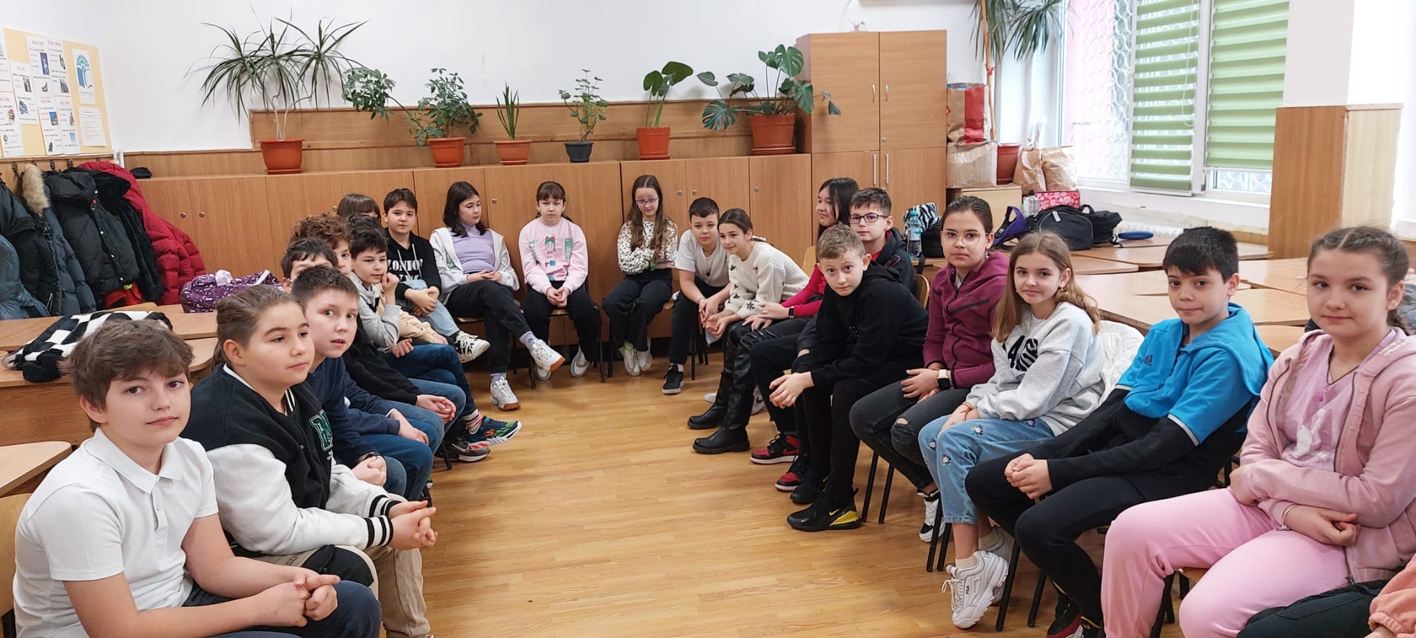
Our initiative represents a program that equips young people
with life skills
We invest in young people - We invest in the future!

Slide 9

The guide has 12 worksheets that support each lesson.
We would like them available online to make the lessons more accessible, interesting and attractive for students.
Build your future
MAIN THEMES IN THE GUIDE
bullying,
self-esteem ,
failure can lead to success,
creativity and confidence in one's own potential,
the importance of the right attitude,
healthy choices ,
forgiveness and resolving conflicts,
a good life is built upon good relationships,
how to imagine your future,
awareness of one’s potential.

Slide 10
Build your future
when we started to plan this guide , we thought of 4 important pillars to educate young :
vision
influence
character
prioritization

Slide 11

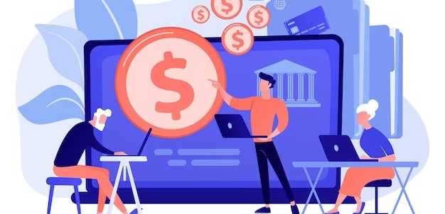
Our curent partner is our national bank - BCR who supports the project
along with also integrating a financial education lesson for children in this GUIDE.

Slide 12

Our OBJECTIVE for the online app are :
to increase students' appetite for personal development
to decrease school dropout rates
the guide becomes a personal development handbook for young people in schools in a maximum of 2 years
from 45.000 students involved in the first 2 years, we want to reach 100.000 new young people in the first year, after the launch of the mobile app

Slide 13
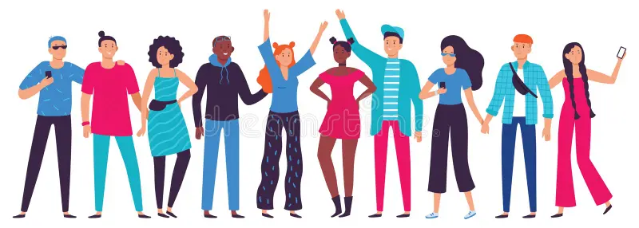
The young people reach breakdown :
With an average of 25 young people in a class x
4 school years x
2 parallel classes x
50 high schools in a county x
41 counties in the country
= 400,000 young people involved ,
We would get the interest of 10 times more young people
comparing to the number reached so far

Slide 14
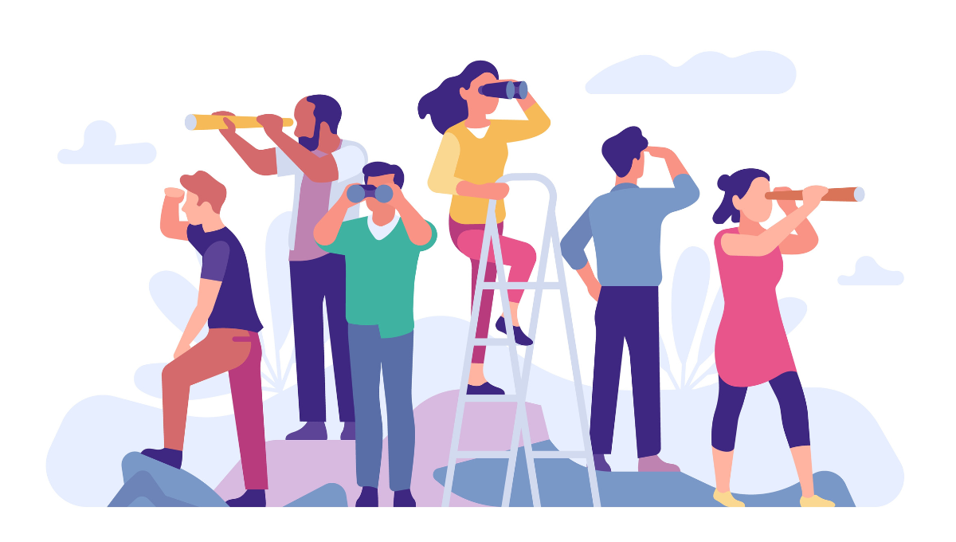
Project perspectives for the next 5 years :
From the end of - 2023 assign young people as project ambassadors of Max Leaders.
From 2025 - to establish 3 hubs in the country where we can mentor and help young people to find their passion
From 2026 - To have online libraries that help young people and support them through education and mentorship
We want to become a NATIONAL VOICE supported by 5000 voluntary member facilitators at the end of 2025 , and 10.000 members in 2027 that will be attracted through our new national programs
And is very important that we want to transform this guide in a manual of leadership in 2 years

Slide 15

The OFFICIAL launch of the Guide
will be held on the 5th of October.
We will have an event held in a representative school.
The guests will be :
the press,
local authorities,
school inspectorate,
town hall,
schools,
teachers .

Slide 16
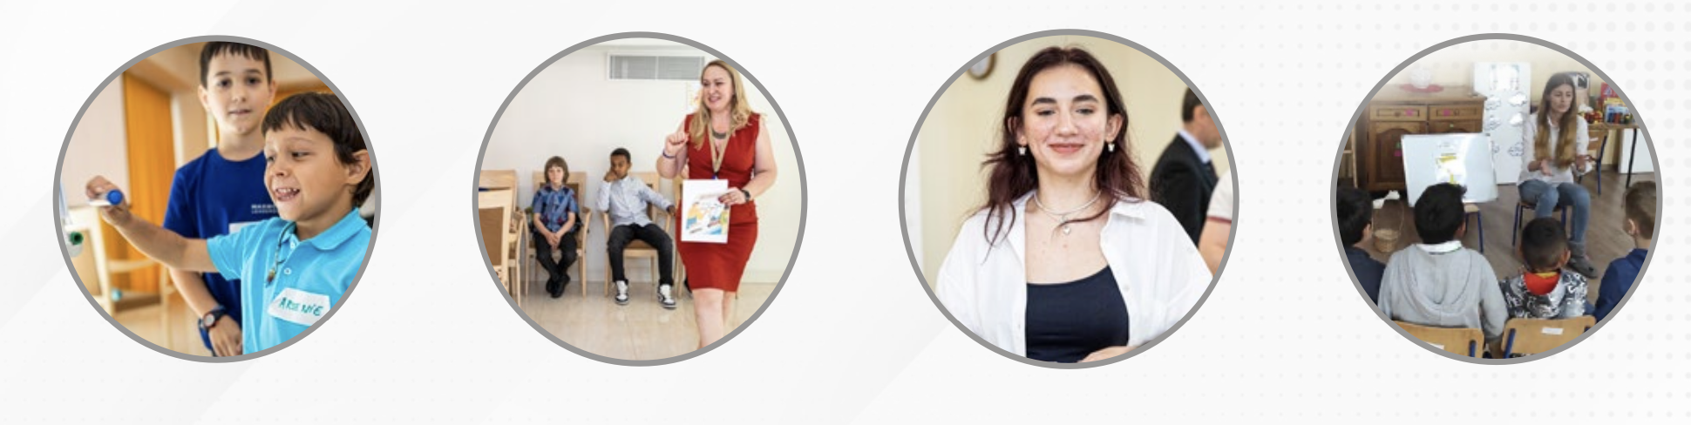
Starting on the 5th of October , the Guide
will be distributed in schools
to the 1500 volunteers
to be used in class during leadership lessons

Slide 17

The Online space is the future,
it supports the project's sustainability and traceability
through the guide’s worksheets
- online application - Max Leaders 2024

Slide 18

We must hurry the project’s implementation because generations of young people
finish school year after year without being equipped with basic knowledge of leadership.
This is our biggest motivation
to let the future generations enjoy the advantages brought by this knowledge right now.

Slide 19
THANK YOU !

